Slide 1
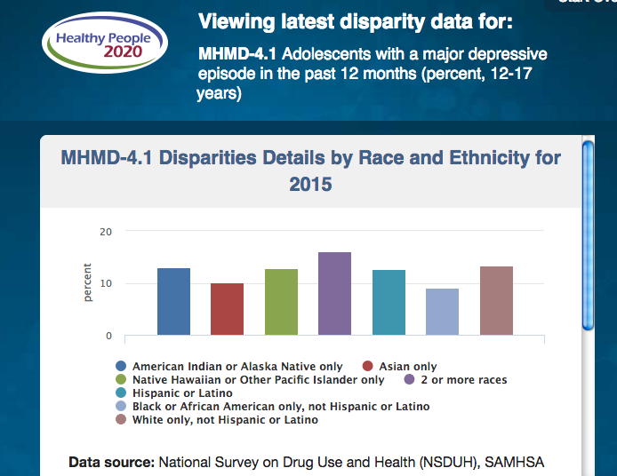
Amer. Indian / Alaska N.
2 or more races
Latino
White
Pac. Isl.
Black/ AfAm
Asian
https://minorityhealth.hhs.gov/omh/browse.aspx?lvl=2&lvlid=93

Slide 2
% of Population, age 18 + older, United States with feelings of sadness, hopelessness, worthlessness or that “everything is an effort, all the time, 2014

Slide 3
Age-adjusted Death Rates for Suicide: Ages 15-19 (per 100,000 people) United States, 2014

Slide 4
% of students, grades 9-12, United States
who seriously considered suicide, 2015

Slide 5
% of Adults age 18 + up, United States,
who received mental health treatment or counseling in the past year., 2014

Slide 6
% of Adults age 18 + up, United States, 2014
received prescription medications for mental health treatment or counseling in the past year

Slide 7
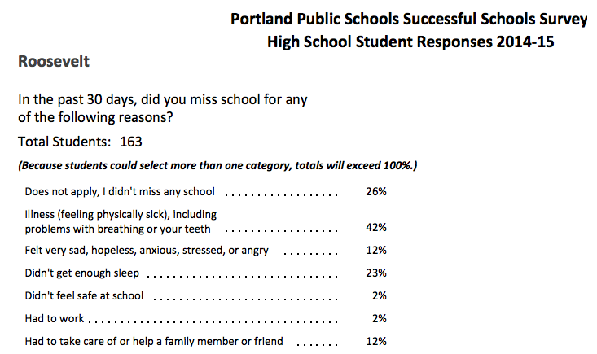

Slide 11
Mental health counselors around North Carolina are reporting a marked increase in patients experiencing stress and other mental health symptoms in the aftermath of last Saturday’s “Unite the Right” white supremacist rally in Charlottesville, Virginia, which broke out in violence and left a counterprotester dead.
The complaints follow a recognizable pattern: anxiety, depression, anger, confusion, helplessness.
In recent days in Google searches in the area around Charlotte for “psychologist near me,” greatly increased, suggesting people are struggling to mentally process last weekend’s political events. At the Charlottesville rally, a white nationalist protester drove his car into a group of counterprotesters, killing one and injuring others.
http://www.newsobserver.com/news/business/article167989997.html

Slide 12
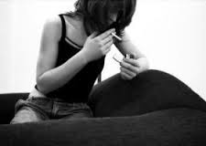
Pam Perkins of Perkins Counseling and Psychological Services in Wake Forest, North Carolina, said the symptoms of emotional overload can be uncontrollable racing thoughts, heightened levels of adrenalin and hyper-vigilance. The N.C. Psychological Association on Friday issued a statement condemning bigotry and noting that exposure to discrimination can lead to depression, suicidal thoughts and substance abuse.
Read more here: http://www.newsobserver.com/news/business/article167989997.html#storylink=cpy

Slide 13
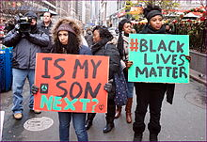
Joy Harden Bradford, PhD, a psychologist and the creator of Therapy for Black Girls, explains the impact of being online during heightened times of violence: “Visual memories are our most powerful memories so constantly seeing videos and images of people being killed and attacked, these white supremacist gatherings, police brutality, and all the other images we are bombarded with can take a toll on your system.”
While we may sometimes feel the need to post and write about current events like the white nationalist marches and attacks in Charlottesville, Virginia, it is also important to remember that the exposure to so much frightening news can lead to feelings of hopelessness, despair and a sense of paranoia whether the environments you are in are safe or not, according to Bradford.
Teen Vogue
http://www.teenvogue.com/story/ self-care-tips-people-of-color- charlottesville

Slide 14
The constant or frequent exposure to images of violence online can manifest itself in different ways, explains Philadelphia-based licensed professional counselor Katrina Pinkney — including hopelessness, low self-esteem and self-confidence. Symptoms of racial trauma that go unnoticed or untreated can eventually build up to more severe symptoms like depression, anxiety and PTSD.
Teen Vogue http://www.teenvogue.com/story/self-care-tips-people-of-color-charlottesville

Slide 15
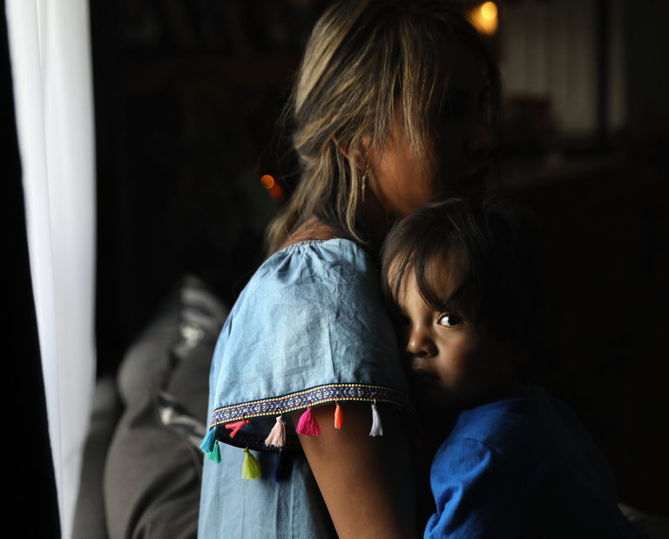
Life as an undocumented immigrant in America is hard on the mind and body. Poverty, precarious employment, poor access to health care, discrimination and trauma from the migration itself often lead to disorders like depression, anxiety and post-traumatic stress disorder. Access to mental health treatment is limited, the demands of simply surviving are overwhelming, the fear of being discovered discourages people from seeking care, and the stigma of mental illness has perpetuated a culture of silence that only worsens the suffering.
https://www.nytimes.com/2017/09/08/opinion/sunday/mental-health-daca.html?_r=0

Slide 16
As a graduate student, I have interviewed dozens of undocumented people, including first-wave adults. Most of them speak of symptoms that we might call anxiety, depression and PTSD, even if the subjects themselves do not use this language, and have less familiarity with diagnostics and less access to treatment than their American-citizen children. These studies are from a more innocent time.
All of the immigrants I have interviewed and known throughout my life seem to accept chronic exhaustion, low self-esteem, fear and panic, low moods and fits of crying as normal for the melancholic migrant struggling to subsist without being arrested. Older immigrants are at the highest risk for mental health struggles, having aged out of manual labor, with grown children and dead parents, and being unable to receive health care.
https://www.nytimes.com/2017/09/08/opinion/sunday/mental-health-daca.html?_r=0

Slide 17
Alejandro is a 49-year-old day laborer from Mexico who rents a room in Staten Island, to which he returns only at night to eat a dinner of oatmeal with milk and sugar, and then sleep. He has crossed the border four times to see his children but is too old for that now. Some of the trips were traumatizing. On one, a middle-aged man got so dehydrated that he could no longer swallow. “I can’t stop thinking of his face, the look in his eyes,” he says. Alejandro himself got so tired on that trip that he felt like giving up and surrendering to death, perhaps to be eaten by bobcats. But two young men lifted him up and pushed him by his shoulders up the slopes of a mountain. “They didn’t want me to die, and I didn’t want to let them down, so I lived,” he recalled. “I can’t stop thinking about them. When the news comes on, I worry I will see them being deported.”
https://www.nytimes.com/2017/09/08/opinion/sunday/mental-health-daca.html?_r=0

Slide 18
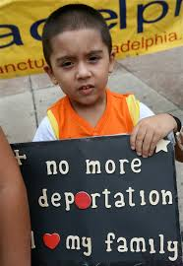
William is a 16-year-old Dominican martial arts star who loves math and science but also struggles with anxiety and depression. “After the election, I thought I was lower than everyone in society, that I had no voice or role or place here — an alien, like people say,” he told me. He began to fear ICE was following him at all times and he had a nervous breakdown. “But then I got to a point where I didn’t care because I knew I was going to commit suicide and nothing would bother me after death,” he says. He was put on Zoloft and hospitalized for a week.
https://www.nytimes.com/2017/09/08/opinion/sunday/mental-health-daca.html?_r=0

Slide 19
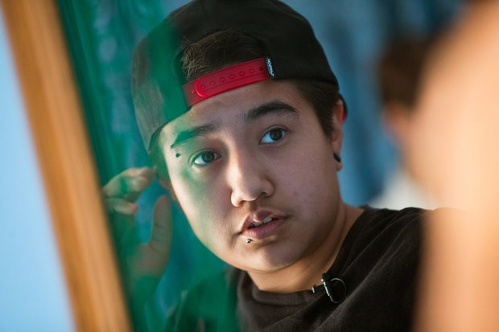
Jay faced the bathroom mirror. He was 14. His dark brown hair spiked just the right way. His jaw was square, his eyebrows full and wild. But his body betrayed him. He was 5-foot-2 and curvy in all the wrong places. He was 12 when "girl" started to feel like the wrong word for him. He didn't know what he was, yet. Some days, he couldn't bring himself to walk the hallways. He skipped class at least once a week in seventh grade. He passed whole days in bed, the sheets pulled up to his neck. In the shadows of his bedroom, Jay could be almost nothing at all.
His mother took him to doctors, but there was no word for the way Jay felt. He struggled to explain that he felt sick because he didn't feel like himself.
I feel like I am walking on glass, he wanted to say. But the words came out, "My stomach hurts."
http://www.oregonlive.com/transgender-health/2017/07/about_a_boy_jays_life_as_a_tra.html

Slide 41
